Slide 1
Securing understanding of ordering and comparing numbers
Place value

Slide 2
how to use Oak lessons

Slide 3
I can confidently order and compare a variety of numbers and measures.

Slide 4
An inequality is used to show that one number or measurement is not equal to another.
The inequality symbols are < which means ‘less than’ and > which means ‘greater than’.

Slide 5

Securing understanding of ordering and comparing numbers
Comparing measures
Ordering measures

Slide 6



Comparing measures
Who drank more water? How can you tell?
I drank 1.75 litres of water today.
I drank more than you! I drank 1705 millilitres of water.
Aisha
Alex
When you compare measures, it can be useful to have the same units.

Slide 7

Comparing measures
Compare 1.75 litres and 1705 millilitres.
Select the correct statement.
1.75 is less than 1705, so 1705 ml is more.
You can convert 1.75 litres into millilitres to compare them.
Litres are bigger than millilitres, so 1.75 litres is more.

Slide 8
Comparing measures
You can use a place value chart to convert units.
litres | deci | centi | milli
1 7 5
1.75 litres
1 7 5
17.5 decilitres
1 7 5
175 centilitres
1 7 5 0
1750 millilitres
I was wrong, I drank 1705 millilitres of water which is less than Aisha.
Alex
1.75 litres = 1750 millilitres

Slide 9
Comparing measures
The symbols < and > are inequality symbols. An inequality shows that two quantities are not equal.
1705 ml < 1750 ml
1705 millilitres is less than 1750 millilitres.
1750 ml > 1705 ml
1750 millilitres is greater than 1705 millilitres.
Aisha

Slide 10
Comparing measures
Select the correct statement.
1.75 l < 1705 ml
1.75 litres = 1750 millilitres
1705 ml is less than 1750 ml
1705 ml < 1.75 l
1705 ml = 1.75 l

Slide 11
Comparing measures
4.334 kg > 4.34 kg
The number with more digits after the decimal point is greatest.
The first digit that is different is in the hundredths place. This is less in 4.334 kg than 4.34 kg

Slide 12



Comparing measures
Use an inequality symbol to complete the statement. 166 cm 1.6 m
Use an inequality symbol to complete the statement. 20 cm 0.22 m
deca | metres | deci | centi
 | 1 | 6 | 6
deca | metres | deci | centi
 | 0 | 2 | 0
1 cm = of a metre = 0.01 m
1 cm = of a metre = 0.01 m 20 cm = of a metre = 0.2 m 0.2 m < 0.22 m, so 20 cm < 0.22 m
166 cm = of a metre = 1.66 m
1.66 m > 1.6 m, so 166 cm > 1.6 m

Slide 13
Comparing measures
1) Write the correct symbol (<, > or =) to complete each statement.
a) 1.23 m 12.3 cm b) 0.456 kg 465 g c) 570 mm 7.5 cm
d) 985 000 m 958 km e) 30 000 ml 30 l f) 989 cl 9980 ml
You can use this place value chart to help you with conversions.
 |  | kilo | hecto | deca |  | deci | centi | milli

Slide 14
Comparing measures
2) Write a digit on each solid line and a symbol (<, > or =) on each dotted line to complete each statement.
a) .29 m = 2 cm
b) 3.48 kg …… 34 0 g
c) 13 400 cm …… 0. 5 km
d) 0.098 m ….. 99 mm e) 20 ml ….. 0.2 litres f) 78 mg ….. 0.0 g
You can use this place value chart to help you with conversions.
 | kilo | hecto | deca |  | deci | centi | milli

Slide 15
Comparing measures
3) You have six cards:
Complete this statement in as many ways as possible.
0.879 kg g
7
8
9
<
>
=

Slide 16
Comparing measures
1) Write the correct symbol (<, > or =) to complete each statement.
a) 1.23 m > 12.3 cm b) 0.456 kg < 465 g c) 570 mm > 7.5 cm
d) 985 000 m > 958 km e) 30 000 ml = 30 l f) 989 cl < 9980 ml
You can use this place value chart to help you with conversions.
 |  | kilo | hecto | deca |  | deci | centi | milli

Slide 17
Comparing measures
2) Write a digit on each solid line and a symbol (<, > or =) on each dotted line to complete each statement.
a) 0 . 29 m = 2 9 cm b) Possible answers include: 3.48 kg = 34 8 0 g 3.48 kg < 34 9 0 g 3.48 kg > 34 7 0 g c) Possible answers include: 13 400 cm < 0. 1 5 km 13 400 cm > 0. 0 5 km

Slide 18
Comparing measures
2) Write a digit on each solid line and a symbol (<, > or =) on each dotted line to complete each statement.
d) 0.098 m < 99 mm e) Possible answers include: 20 0 ml = 0.2 litres 20 1 ml > 0.2 litres f) Possible answers include: 78 mg < 0.0 8 g 78 mg > 0.0 7 g

Slide 19
Comparing measures
3) You have six cards:
Complete this statement in as many ways as possible.
0.879 kg = 879 g 0.879 kg < 978 g 0.879 kg > 789 g 0.879 kg < 897 g 0.879 kg < 987 g 0.879 kg > 798 g
7
8
9
<
>
=
0.879 kg g

Slide 20
Securing understanding of ordering and comparing numbers
Comparing measures
Ordering measures

Slide 21

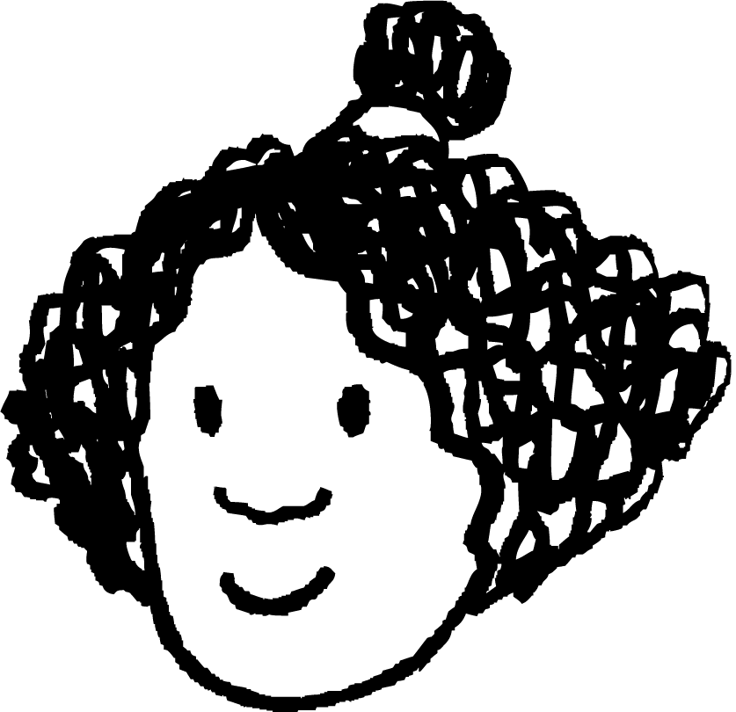

Ordering measures
Who is right? Justify your answer.
Jacob
My dog is huge! He is 120 cm from nose to tail.
My dog is bigger than yours! He weighs 30 kg.
My dog is the biggest. He drinks 850 ml of water every day!
Sofia
Izzy
It is impossible to tell who is right. You cannot compare different types of measurement.

Slide 22
Ordering measures
When ordering measures:
lengths can only be compared to other lengths.
masses can only be compared to other masses.
capacities can only to be compared to other capacities.

Slide 23
Ordering measures
Select the list which can be ordered.
1110 litres, 110 mg, 1100 cl, 1100 ml
2.2 km, 220 m, 2200 cm, 22 000 mm
3.3 kg, 3330 g, 3 330 000 ml, 0.3 kg
4.44 kg, 4.44 km, 4.44 m, 4.44 litres

Slide 24


Ordering measures
How can you order these journeys?
Aisha walked 423 m to school.
Laura walked 324 000 cm to school.
Sofia walked 2.34 km to school.
Andeep walked 432 000 mm to school.
2.34 km = 2.34 ✖ 1000 metres = 2340 m
324 000 cm = 324 000 ✖ metres = 3240 m
432 000 mm = 432 000 ✖ metres = 432 m
So, 423 m < 432 000 mm < 2.34 km < 324 000 cm

Slide 25
Ordering measures
Which of these lists is incorrect?
2.2 mm < 2.2 cm < 2.2 m < 2.2 km
22 mm < 0.2002 m < 22 cm < 0.202 km
0.0022 km < 202 cm < 2.2 m < 2002 mm

Slide 26
Ordering measures
1) Starting with the smallest, sort the measures into ascending order.
a) 99 cm, 99 mm, 99 km, 99 m
b) 303 ml, 0.03 l, 30 cl, 0.33 l
c) 0.456 km, 465 m, 64.5 cm, 564 mm
d) 35 700 mg, 7.53 kg, 7503 g, 3.57 g
e) 986 cm, 0.896 m, 0.00869 km, 689 mm

Slide 27
Ordering measures
2) Use these cards to complete each inequality.
Use each card only once in each statement. Can you find more than one way to complete the inequalities? a) b)
.
0
1
2
8
9
2 cm < 1 mm < 0 m
0 kg < 8 g < 00 000 mg < 0. kg

Slide 28
Ordering measures
1) Starting with the smallest, sort the measures into ascending order.
a) 99 mm, 99 cm, 99 m, 99 km
b) 0.03 l, 30 cl, 303 ml, 0.33 l
c) 564 mm, 64.5 cm, 0.456 km, 465 m
d) 3.57 g, 35 700 mg, 7503 g, 7.53 kg
e) 689 mm, 0.896 m, 0.00869 km, 986 cm

Slide 29
Ordering measures
2) Use these cards to complete each inequality.
Use each card only once in each statement. Can you find more than one way to complete the inequalities?
a) Possible answers include: 1.2 cm < 180 mm < 0.29 m or 1.2 cm < 190 mm < 0.82 m
b) There is only one possible answer. 0.08 kg < 89 g < 100 000 mg < 0.2 kg
.
0
1
2
8
9

Slide 30
Securing understanding of ordering and comparing numbers
You can use a place value chart to help you convert between measurements.
You can use an inequality symbol ( < or > ) to compare two measurements that are not equal.
You can order a list of three or more measurements by writing them all using the same units.

Slide 31

© Oak National Academy 2023.
Produced in partnership with Mathematics in Education and Industry.
Licensed on the Open Government Licence v3.0, except where otherwise stated. See Oak terms and conditions.

